Slide 1
Micro-Credit Defaulter Model
Ravi prakash bajpai

Slide 2
Introduction
This project deals with a Microfinance Institution (MFI) providing the services of Microfinance using the mobile financial services (MFS). These institutions generally works with families having low income living in the remote area. The Microfinance services (MFS) provided by MFI are Group Loans, Agricultural Loans, Individual Business Loans and so on.
These institutions provided small amount of credit to their customers for short period of time. Loan amount is generally provided through mobile balance .suppose it provides loan credit of 5 rupiah then customer have to pay back 6 rupiah within 5 days. If customers are unable to pay back the amount within time limit that is 5 days then he will be considered as defaulter.
The sample data is provided for improving the selection of customers for the credit, the client wants some predictions that could help them in further investment and improvement in selection of customers

Slide 3
EDA AND VISUALIZATION
Ploting all the features in distplot,from distplot it is observed that nearly in all the features skewness is present and data is not in normal form.
For rechecking the data skew funtion has been applied.considering as 8 as normal value we can see that in many features values in skewness is more than 8.its means that features having value more than 8 have skewness in the data

Slide 4
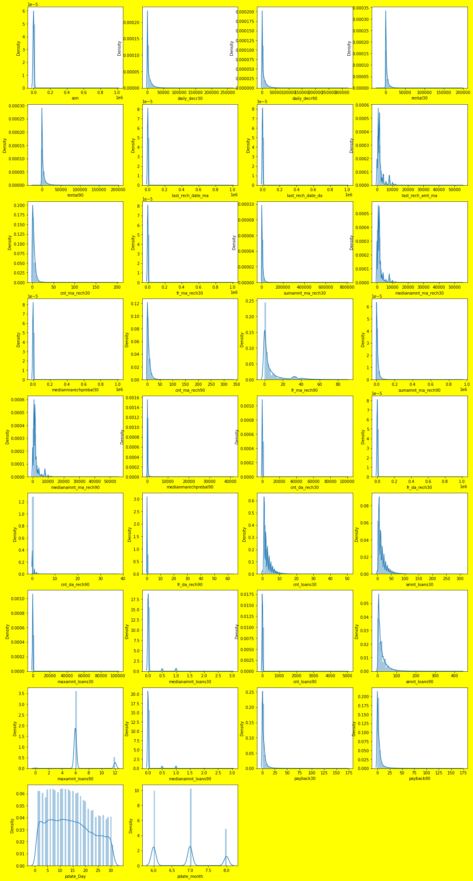

Slide 5
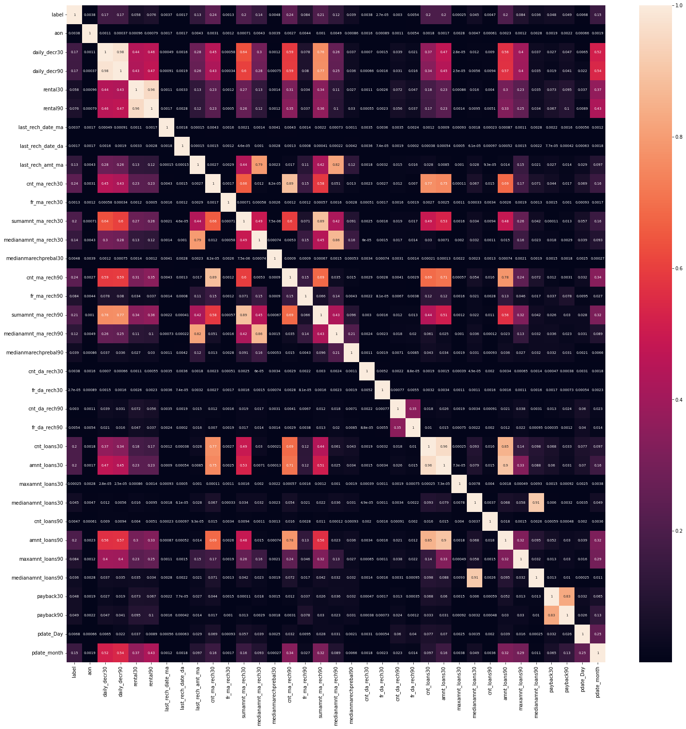
HEAT MAP

Slide 6
HEAT MAP OBSERVATION
Ploting the heat map of the given data set to find the multicolinearity in the given data set. From the given dataset following points are observed
amnt_loans30 and amnt_loan90 are highly correlated with each other.
medianamnt_loans30 and medianamnt_loans_90 are corelated with each other.
daily_decr30 and daily_decr90 are highly corelated with each other.
rental30 and rental90 are highly corelated with each other.
cnt_ma_rech30 and cnt_ma_rech90 are correlated with each other.
cnt_loans30 and amnt_loans30 are correlated with each other.
So after the result of haet map some of features which are showing multicolinearity has been droped,these column are medianamnt_loans90, daily_decr90, rental30, cnt_loans30

Slide 7
Z SCORE,IMBALANCE DATA,STANDARD SCALER
Z score
Applying z score for removal of skewness from the features of the data set. skewness has been removed as seen in results.
Imbalance data
From label count it can be seen clearly that label is not balanced. 1 count are 140497 and 0 count are only 22508.
Standard scaler
Spliting features and label and assigning them in different variables,then applying the standard scaler on the data set.
Train test split
Applying train test split on the scaled data, where for training the data 75 percent of whole data has been taken and for testing 25 percent data has been taken.

Slide 8
SMOTE
From value count function it can be clearly seen that data is imbalanced 1 count is more than 0 count, for balancing the data applying SMOTE function on data. After applying smote function we can see that 0 and 1 count are nearly equivalent.
Now data is ready for model applying different model to predict the defaulter customers

Slide 9
Model/s Development and Evaluation
As it can be seen from label that given algorithm is classification type and it is binary classification. That is only 2 results can be seen 0 and 1. So applying different classification algorithms to predict the customers whether they are defaulter or not.
Algorithm used to predict the labels along with their classification report and results
LOGISTIC REGRESSION
Accuracy score:-74%
DECISION TREE
Accuracy score- 86 %
KNN CLASSIFIER
Accuracy score – 77%
RANDOM FOREST CLASSIFIER
Accuracy score – 90%

Slide 10
HYPERPARAMETER TUNING

Slide 11
CONCLUSION
So considering the random forest classifier as algorithm for the given problem without taking the best parameter of grid search cv

